Slide 1
.NET
Unit 8
2160711
ASP.NET: Introduction to ASP.NET, Working with Web and HTML Controls, Using Rich Server Controls, Login controls, Overview of ASP.NET Validation Controls, Using the Simple Validations, Using the Complex Validators Accessing Data using ADO.NET, Configuration Overview

Slide 2
GTU Questions
1 | Explain various Validation controls for ASP.NET with example | 7
2 | What is difference between ASP and ASP .NET? | 1
3 | Explain Page Life Cycle of ASP.NET. | 3
4 | Can you explain what is happening in following Controls? 1. Calender 2. AdRotator 3. Gridview 4. ListBound | 4
5 | What is the importance of web.config file in web application? | 3
6 | Write a program to change color of Label text control programmatically in Asp .Net | 4
7 | Answer following with respect to ASP .NET page. i. What is Set as Start Page option? ii. Which server is needed to run Page? iii. How to view output of page? | 3
8 | What is AJAX? Give ASP.Net code to use Update Panel control. | 7

Slide 3


HTML
HTML

Slide 4


ASP
Active Server Pages
ASP

Slide 5
ASP
Active Server Pages or Classic ASP is Microsoft's first server side scripting engine that enables you to make dynamic and interactive web pages.
uses server-side scripting.
The default scripting language used for writing ASP is VBScript, although you can use other scripting languages like JScript (Microsoft's version of JavaScript).
extension .asp instead of .htm
The page must be requested through a web server that supports ASP.
Active Server Pages

Slide 6
Difference with ASP
ASP
ASP.NET
Interpreted
Uses ADO
HTML and coding in same file
No xml support
written using VB Script and HTML
Doesn’t support cross languages.
Not object oriented
Compiled
Uses ADO.NET
Different code behind file
Supports xml
.NET compliant languages
Web services and Cross language support
Object oriented
ASP.NET

Slide 7
Life Cycle
1.Page Request
2.Start
3.Initialization
4.Load
5.Postback Event Handling
6.Rendering
7.Unload
ASP.NET

Slide 8
Life Cycle
1.Page Request
2.Start
3.Initialization
4.Load
5.Postback Event Handling
6.Rendering
7.Unload
1.Page Request
When the page is requested by a user. The page request occurs before the page life cycle begins.
ASP.NET

Slide 9
Life Cycle
1.Page Request
2.Start
3.Initialization
4.Load
5.Postback Event Handling
6.Rendering
7.Unload
2.Start
In the start stage, page properties such as Request and Response are set. At this stage, the page also determines whether the request is a postback or a new request and sets the IsPostBack property.
ASP.NET

Slide 10
Life Cycle
1.Page Request
2.Start
3.Initialization
4.Load
5.Postback Event Handling
6.Rendering
7.Unload
3.Initialization
During page initialization, controls on the page are available. A master page and themes are also applied to the page if applicable.
ASP.NET

Slide 11
Life Cycle
1.Page Request
2.Start
3.Initialization
4.Load
5.Postback Event Handling
6.Rendering
7.Unload
4.Load
During load, if the current request is a postback, control properties are loaded with information recovered from view state and control state.
ASP.NET

Slide 12
Life Cycle
1.Page Request
2.Start
3.Initialization
4.Load
5.Postback Event Handling
6.Rendering
7.Unload
5.Postback Event Handling
If the request is a postback, control event handlers are called. After that, the Validate method of all validator controls is called, which sets the IsValid property of individual validator controls and of the page.
ASP.NET

Slide 13
Life Cycle
1.Page Request
2.Start
3.Initialization
4.Load
5.Postback Event Handling
6.Rendering
7.Unload
6.Randering
Before rendering, view state is saved for the page and all controls. During the rendering stage, the page calls the Render method for each control, providing a text writer that writes its output to the OutputStream object of the page's Response property.
ASP.NET

Slide 14
Life Cycle
1.Page Request
2.Start
3.Initialization
4.Load
5.Postback Event Handling
6.Rendering
7.Unload
7.Unload
The Unload event is raised after the page has been fully rendered, sent to the client, and is ready to be discarded. At this point, page properties such as Response and Request are unloaded and cleanup is performed.
ASP.NET

Slide 15
Server Controls
ASP.NET uses five types of web controls
HTML controls
HTML Server controls
ASP.NET Server controls
ASP.NET Ajax Server controls
User controls/custom controls
ASP.NET

Slide 16
Server Controls
ASP.NET uses five types of web controls
HTML controls
HTML Server controls
ASP.NET Server controls
ASP.NET Ajax Server controls
User controls/custom controls
ASP.NET
Validation controls
Data source controls
Data view controls
Login and security controls
Navigation controls
Rich controls

Slide 17
Server Controls
<asp:controlType ID ="ControlID" runat="server" Property1=value1 [Property2=value2] />
<asp:Button ID="Button1" runat="server" Font-Bold="True" Font-Italic="True" ForeColor="#CC00CC" Text="Button" />
<asp:CheckBox ID="CheckBox1" runat="server" Font-Bold="True" />
<asp:RadioButton ID="RadioButton1" runat="server" Text="Morning" />
<asp:Label ID="Label1" runat="server" Text="Label"></asp:Label>
ASP.NET

Slide 18
Server Control Properties
Property | Description
AccessKey | Pressing this key with the Alt key moves focus to the control.
BackColor | Background color.
BorderColor | Border color.
BorderStyle | Border style.
BorderWidth | Border width.
Height | Gets or sets the Height of the Web server control.
Width | Gets or sets the Width of the Web server control.
CausesValidation | Indicates if it causes validation.
CssClass | CSS class
Font | Font.
Forecolor | Foreground color.
TabIndex | Gets or sets the tab index of the Web server control.
ToolTip | Gets or sets the text displayed when the mouse pointer hovers over the web server control.
ASP.NET

Slide 19
Rich Controls
AdRotator control
Calendar control
FileUpload control
MultiView control
Wizard control
ASP.NET

Slide 20
AdRotator control
Used to display different advertisements randomly in a page.
Elements of XML file
ImageUrl:
The URL of the image that will be displayed through AdRotator control.
NavigateUrl:
If the user clicks the banner or ad then the new page is opened according to given URL.
AlternateText:
It is used for displaying text instead of the picture if picture is not displayed. It is also used as a tooltip.
Impressions:
It is a number that sets how frequently an advertisement will appear.
Keyword:
It is used to filter ads or identifies a group of advertisement.
ASP.NET

Slide 21
AdRotator control
<Advertisements>
<Ad>
<ImageUrl>∼\Images\patanjali.jpeg</ImageUrl>
<NavigateUrl>~\Patanjali.aspx</NavigateUrl>
<AlternateText>Advertisement</AlternateText>
<Impressions>1</Impressions>
<Keyword>patanjali</Keyword>
</Ad>
<Ad>
<ImageUrl>∼\Images\colgate.jpeg</ImageUrl>
<NavigateUrl>~\Colgate.aspx</NavigateUrl>
<AlternateText>Advertisement</AlternateText>
<Impressions>2</Impressions>
<Keyword>colgate</Keyword>
</Ad>
</Advertisements>
ASP.NET

Slide 22
AdRotator control
Properties | Description
AdvertisementFile | The path to the advertisement file.
AlternateTextFeild | The element name of the field where alternate text is provided. The default value is AlternateText.
DataSourceID | Id of the control from where it would retrieve data.
ImageUrlField | The element name of the field where the URL for the image is provided. The default value is ImageUrl.
KeywordFilter | For displaying the keyword based ads only.
NavigateUrlField | The element name of the field where the URL to navigate to is provided. The default value is NavigateUrl.
Target | The browser window or frame that displays the content of the page linked.
ASP.NET

Slide 23
AdRotator control
<asp:AdRotator ID="AdRotator1" runat="server" AdvertisementFile="~/AdRotator.xml“ target="_blank" NavigateUrlField="NavigateUrl" KeywordFilter="colgate" />
ASP.NET

Slide 24
Calender control
Displaying one month at a time
Selecting a day, a week or a month
Selecting a range of days
Moving from month to month
Controlling the display of the days programmatically
ASP.NET
<asp:Calendar ID="Calendar1“ runat="server">
</asp:Calendar>

Slide 25
Calender control
Properties | Description
Caption | Gets or sets the caption for the calendar control.
CaptionAlign | Gets or sets the alignment for the caption.
CellPadding | Gets or sets the number of spaces between the data and the cell border.
CellSpacing | Gets or sets the space between cells.
DayHeaderStyle | Gets the style properties for the section that displays the day of the week.
DayNameFormat | Gets or sets format of days of the week.
DayStyle | Gets the style properties for the days in the displayed month.
FirstDayOfWeek | Gets or sets the day of week to display in the first column.
NextMonthText | Gets or sets the text for next month navigation control. Default value is >.
SelectedDate | Gets or sets the selected date.
ASP.NET

Slide 26
Calender control
<asp:Calendar ID="Calendar1" runat="server"
Caption="Select Date"
CaptionAlign="Left"
CellPadding="5"
DayNameFormat="FirstLetter" FirstDayOfWeek="Thursday" NextMonthText="&amp;gt;" OnSelectionChanged="Calendar1_SelectionChanged" SelectedDate="02/27/2019 09:16:16">
<DayHeaderStyle BackColor="#3366FF" BorderColor="#3333CC"
BorderStyle="Ridge"
ForeColor="White" />
<DayStyle BackColor="#66FFFF"
ForeColor="#660066" />
</asp:Calendar>
ASP.NET

Slide 27
Calender control
Events | Description
SelectionChanged | It is raised when a day, a week or an entire month is selected.
DayRender | It is raised when each data cell of the calendar control is rendered.
ASP.NET

Slide 28
GridView Control
DataGrid
GridView
Introduced in asp.net 1.1
Declarative DataSource Controls can be used only for data selection
Introduced in asp.net 2.0
Declarative DataSource Controls can be used for data selection, paging, sorting, deleting and updating
ASP.NET

Slide 29
GridView Control
DataSource Control
EntityDataSource
LinqDataSource
ObjectDataSource
SiteMapDataSource
SqlDataSource
XmlDataSource
ASP.NET

Slide 30
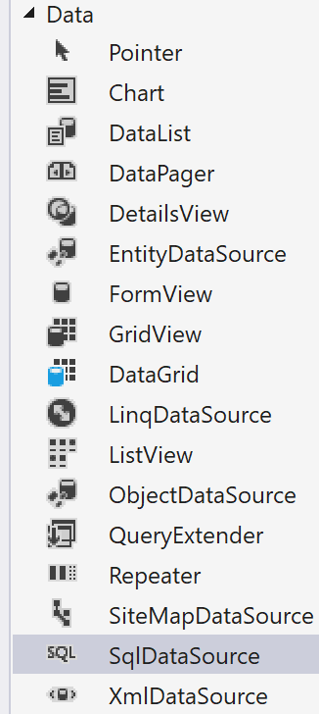
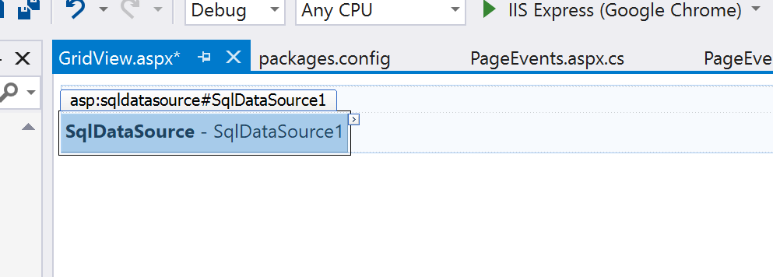
GridView Control
DataSource Control
EntityDataSource
LinqDataSource
ObjectDataSource
SiteMapDataSource
SqlDataSource
XmlDataSource
ASP.NET

Slide 31
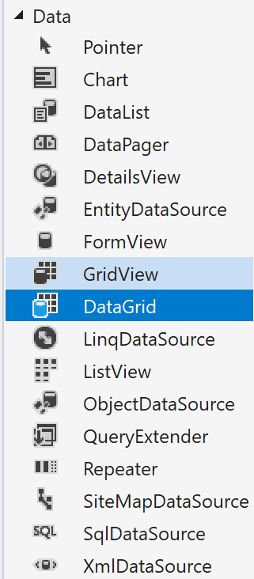
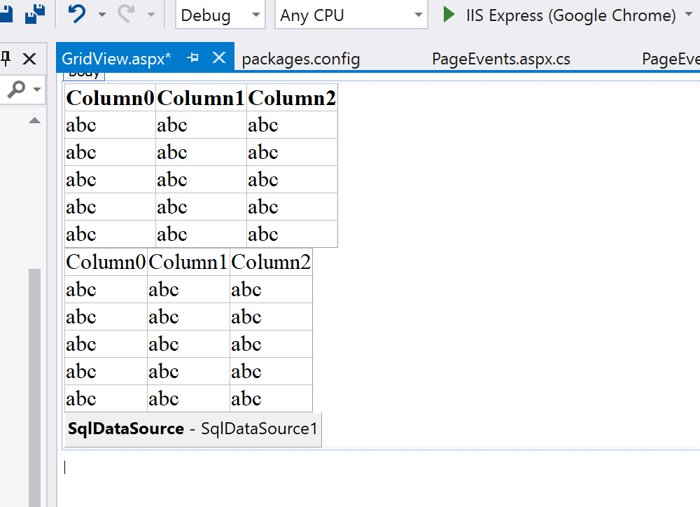
GridView Control
GridView
ASP.NET
DataGrid

Slide 32
GridView Control
d | Short date pattern. | Format: {0:d} 6/15/2009 1:45:30 PM -> 6/15/2009
D | Long date pattern. | Format: {0:D} 6/15/2009 1:45:30 PM ->Monday, June 15, 2009
f | Full date/time pattern (short time). | Format: {0:f} 6/15/2009 1:45:30 PM -> Monday, June 15, 2009 1:45 PM
F | Full date/time pattern (long time). | Format: {0:F} 6/15/2009 1:45:30 PM -> Monday, June 15, 2009 1:45:30 PM
g | General date/time pattern (short time). | Format: {0:g} 6/15/2009 1:45:30 PM -> 6/15/2009 1:45 PM
G | General date/time pattern (long time). | Format: {0:G} 6/15/2009 1:45:30 PM -> 6/15/2009 1:45:30 PM
ASP.NET

Slide 33
GridView Control
C or c | Displays numeric values in currency format. You can specify the number of decimal places. | Format: {0:C} 123.456 -> $123.46 | Format: {0:C3} 123.456 -> $123.456
D or d | Displays integer values in decimal format. You can specify the number of digits. (Although the type is referred to as "decimal", the numbers are formatted as integers.) | Format: {0:D} 1234 -> 1234 | Format: {0:D6} 1234 -> 001234
E or e | Displays numeric values in scientific (exponential) format. You can specify the number of decimal places. | Format: {0:E} 1052.0329112756 -> 1.052033E+003 | Format: {0:E2} -1052.0329112756 -> -1.05e+003
F or f | Displays numeric values in fixed format. You can specify the number of decimal places. | Format: {0:F} 1234.567 -> 1234.57 | Format: {0:F3} 1234.567 -> 1234.567
G or g | Displays numeric values in general format (the most compact of either fixed-point or scientific notation). You can specify the number of significant digits. | Format: {0:G} -123.456 -> -123.456 | Format: {0:G2} -123.456 -> -120
ASP.NET

Slide 34
List Bound Control
ASP.NET
Repeater
DataList
DataGrid

Slide 35
List Bound Control
Repeater
<ItemTemplate>
<table style="background-color:azure">
<tr>
<td style="width:200px" >
<asp:Label ID="Label1" runat="server" Text='<%#Eval("Name") %>'></asp:Label>
</td>
<td>
<table style="background-color:cornsilk; width:300px">
<tr>
<td>Intake:</td>
<td>
<asp:Label ID="Label2" runat="server" Text='<%#Eval("Intake") %>'></asp:Label></td>
</tr>
<tr>
<td>Alias:</td>
<td>
<asp:Label ID="Label3" runat="server" Text='<%#Eval("Alias") %>'></asp:Label></td>
</tr>
<tr>
<td>Start:</td>
<td>
<asp:Label ID="Label4" runat="server" Text='<%#Eval("StartDate") %>'></asp:Label></td>
</tr>
</table>
</td>
</tr>
</table>
</ItemTemplate>
ASP.NET

Slide 36
Validation Control
Required Field Validator
Range Validator
ASP.NET
RE Validator
Compare Validator

Slide 37
Required Field Validator
Properties
ControlToValidate | Gets or sets the input control to validate.
Text | Gets or sets the text displayed in the validation control when validation fails.
ValidationGroup | Gets or sets the name of the validation group to which this validation control belongs.
ErrorMessage | Gets or sets the text for the error message displayed in a ValidationSummary control when validation fails.
ASP.NET

Slide 38
Required Field Validator
<asp:RequiredFieldValidator ID="RequiredFieldValidator1" runat="server"
ControlToValidate="txtName"
ForeColor="Red"
ToolTip="Please provide Details"
Text="*"
Display="Dynamic"
ErrorMessage="Please enter Your Name">
</asp:RequiredFieldValidator>
ASP.NET

Slide 39
Range Validator
<asp:RangeValidator ID="RangeValidator1" runat="server"
ControlToValidate="txtName"
ToolTip="Please Enter Value Between 10 and 30"
ErrorMessage="RangeValidator"
MaximumValue="30" MinimumValue="10" Type="Integer"
ForeColor="Red"
Text="*"
Display="Dynamic"
></asp:RangeValidator>
ASP.NET

Slide 40
Compare Validator
<asp:CompareValidator ID="CompareValidator1" runat="server"
ControlToCompare="txtName"
ControlToValidate="txtName2"
ErrorMessage="CompareValidator"
ForeColor="#FF3300"></asp:CompareValidator>
ASP.NET

Slide 41
Custom Validator
<asp:CustomValidator ID="CustomValidator1" runat="server"
ForeColor="Red"
ControlToValidate="txtDob"
ErrorMessage="CustomValidator" Display="Dynamic" onservervalidate="CustomValidator1_ServerValidate">
</asp:CustomValidator>
ASP.NET

Slide 42
Custom Validator
protected void CustomValidator1_ServerValidate(object source, ServerValidateEventArgs args)
{
int i;
Int32.TryParse(args.Value.ToString(), out i);
if (i > 0)
{
if (args.Value.ToString().Length != 0)
{
if (Convert.ToInt16(args.Value) > 5)
{
args.IsValid = false;
CustomValidator1.Text = "Value must be less than 6";
}
}
else
{
args.IsValid = false;
CustomValidator1.Text = "Please Enter Value";
}
}
else
{
args.IsValid = false;
CustomValidator1.Text = "Please Enter Numeric Value";
}
}
ASP.NET

Slide 43
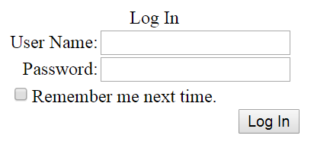
Login Controls
Login
CreateUserWizard
LoginName
LoginStatus
LoginView
PasswordRecovery
ChangePassword
ASP.NET
Provides a user interface for managing the authentication of users in a website.
The authentication is performed on the basis of username and password.
The page access can be restricted by the use of the login controls.

Slide 44
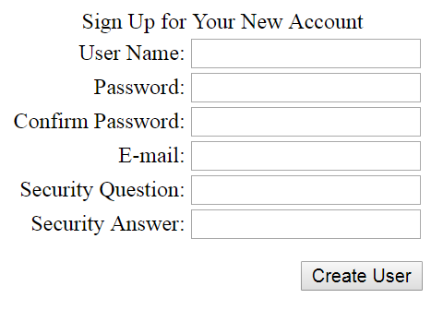
Login Controls
Login
CreateUserWizard
LoginName
LoginStatus
LoginView
PasswordRecovery
ChangePassword
ASP.NET
The control uses the Membership service for creation of a new user. The control can be customized through templates and properties.

Slide 45
Login Controls
Login
CreateUserWizard
LoginName
LoginStatus
LoginView
PasswordRecovery
ChangePassword
It is used for displaying the name of the authenticated users.
The control is not displayed if it does not contain any logged in user. The LoginName class is used for the control.
ASP.NET

Slide 46
Login Controls
Login
CreateUserWizard
LoginName
LoginStatus
LoginView
PasswordRecovery
ChangePassword
It specifies that a particular user has logged into the web site.
The login status is displayed as a text.
The login text is displayed as a hyperlink and provides the navigation to the login page.
The authentication section of the web.config file is useful for accessing the login page URL.
ASP.NET

Slide 47
Login Controls
Login
CreateUserWizard
LoginName
LoginStatus
LoginView
PasswordRecovery
ChangePassword
The LoginView control is a web server control used for displaying the two different views of a web page.
It helps to alter the page view for different logged in users. The current users status information is stored in the control.
The control displays appropriate information depending on the user.
ASP.NET

Slide 48
Login Controls
Login
CreateUserWizard
LoginName
LoginStatus
LoginView
PasswordRecovery
ChangePassword
It is used to recover or reset the password for the user. The password is sent through an email as a message at the registration time.
ASP.NET

Slide 49
Login Controls
Login
CreateUserWizard
LoginName
LoginStatus
LoginView
PasswordRecovery
ChangePassword
The control helps user to change the password.
The user adds the current password and adds the new password.
If the old password is incorrect, the new one cannot be added.
ASP.NET

Slide 50
AjaxControls
AJAX stands for Asynchronous JavaScript and XML.
This is a cross platform technology which speeds up response time.
The AJAX server controls add script to the page which is executed and processed by the browser.
ASP.NET

